Slide 1
Airbnb Project
Diana Melendez, Ericka Houle and Steven Green

Slide 2

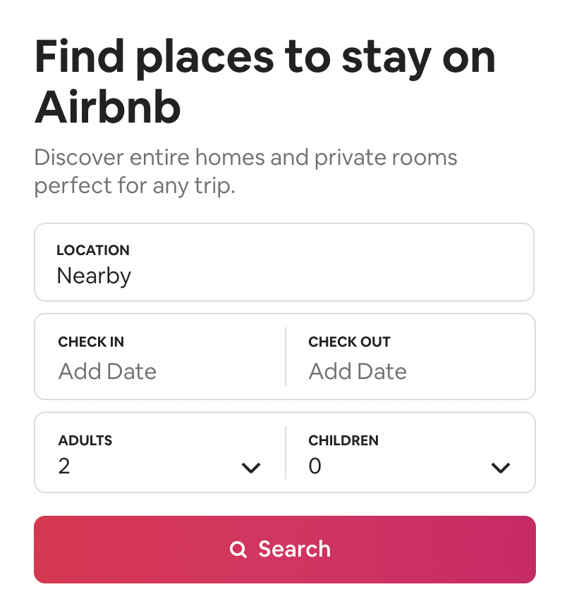
Agenda
Overview
Hypothesis
Data
Analysis
Projection
Limitations & Future Analysis
Q& A

Slide 3

Hypotheses:
Airbnb hosts make more money in urban areas.
There is less competition in rural areas.
Population and income affect Airbnb rates.
Deliverables
Vision
Team

Slide 4
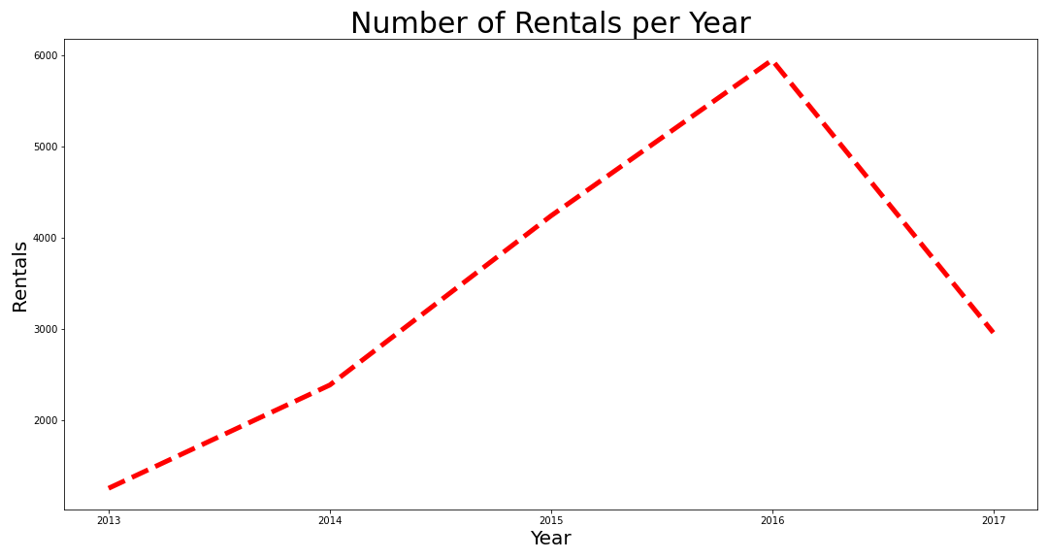
Deliverables
Vision
Team

Slide 5
Map with top 10 counties (urban & rural)
Deliverables
Vision
Team

Slide 6
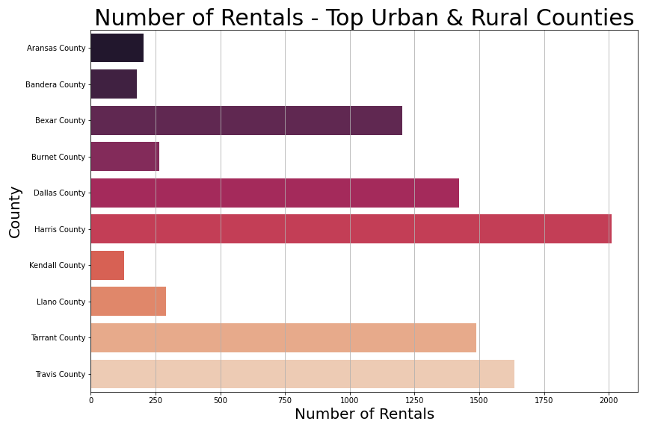
Deliverables
Vision
Team

Slide 7
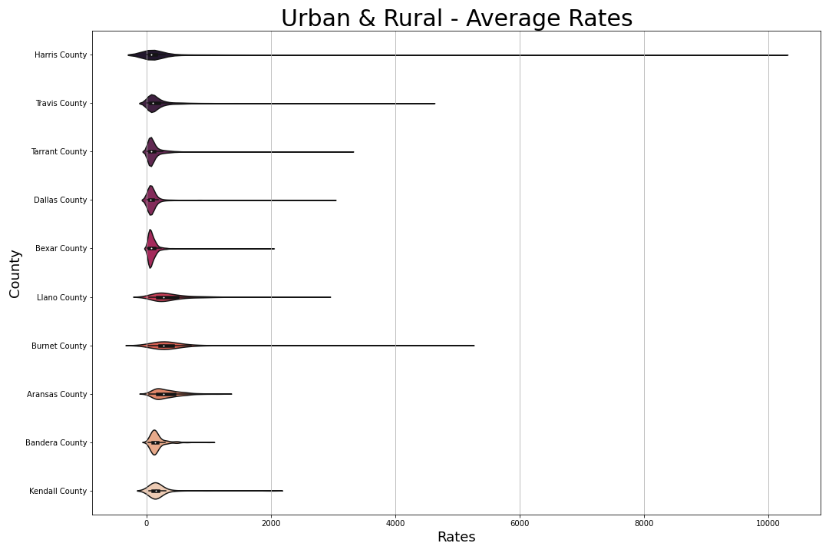

Slide 8
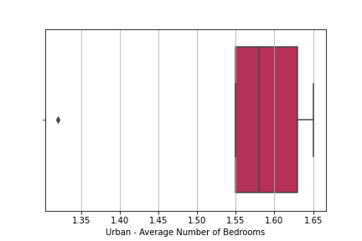
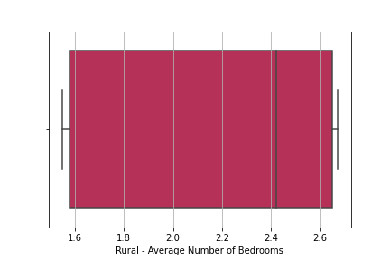

Slide 9
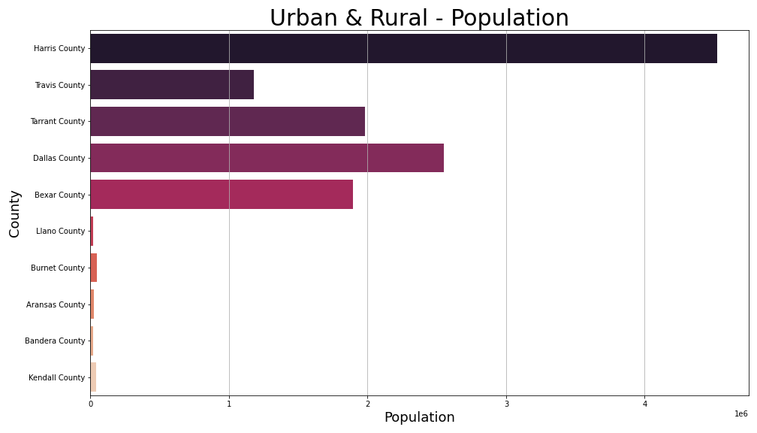

Slide 10
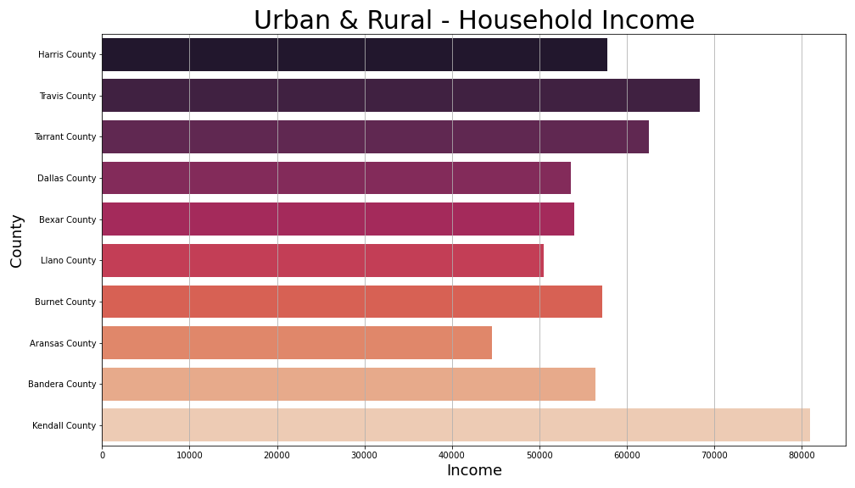

Slide 11
References:
Graphic: https://hbr.org/2019/04/research-when-airbnb-listings-in-a-city-increase-so-do-rent-prices
Deliverables
Vision
Team

